Slide 1

Drive for Show, Putt for Dough
Kyle Murphy, Nathan Kidder, Donnie Canchela, Will Girardi

Slide 2
What data did we use?
The dataset for this activity was obtained from the PGA statistics website.
Cases include all golfers who made the cut in each of 19 PGA tournaments in 2022. The dataset includes variables for driving ability, putting ability, and measuring success in the tournament.
Dataset only includes players that made the CUT. That is the major limitation to this dataset.

Slide 3
What Variables does our dataset have?
The “driving” variables include average driving distance (avgDriveDist), driving accuracy percentage (drivePct), and strokes gained off the tee (driveSG).
The “putting” variables are average putts per round (avgPuttsPerRound), one putt percentage (onePuttPct), and strokes gained putting (puttsSG).
The variables to measure success are scoring average (avgScore), official money won (Money), and Fedex Cup points (Points).

Slide 4
Question 1
Is there a direct correlation between drivePct (% of fairways landed on during weekend) and the onePuttPct (% of time it took one put to make it in the cup)? What is the magnitude of the scatterplot and what is the R^2 value of the scatterplot created?
Analyzing this correlation is important because it helps determine if there's a relationship between a golfer’s accuracy off the tee (drivePct) and their ability to one-putt (onePuttPct).
High correlation: Suggests more fairways hit could lead to better positions for easier putts.
Low correlation: Implies that putting performance might be independent of driving accuracy, focusing attention more on the short game.

Slide 5
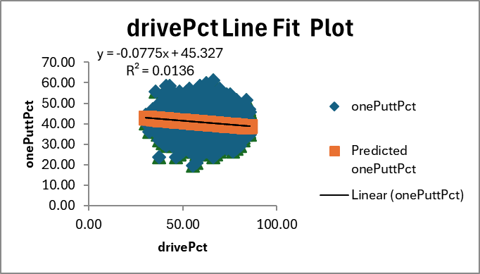
Question 1
Notes:
1. The slope of the regression line is -0.0775.
This means that for each 1% increase in drivePct, the onePuttPct is predicted to decrease by about 0.0775 percentage points.
2. The R² value is 0.0136, which is very low. This indicates that only 1.36% of the variance in onePuttPct can be explained by drivePct. The correlation is weak, suggesting the relationship
between the two variables is very small in magnitude.

Slide 6
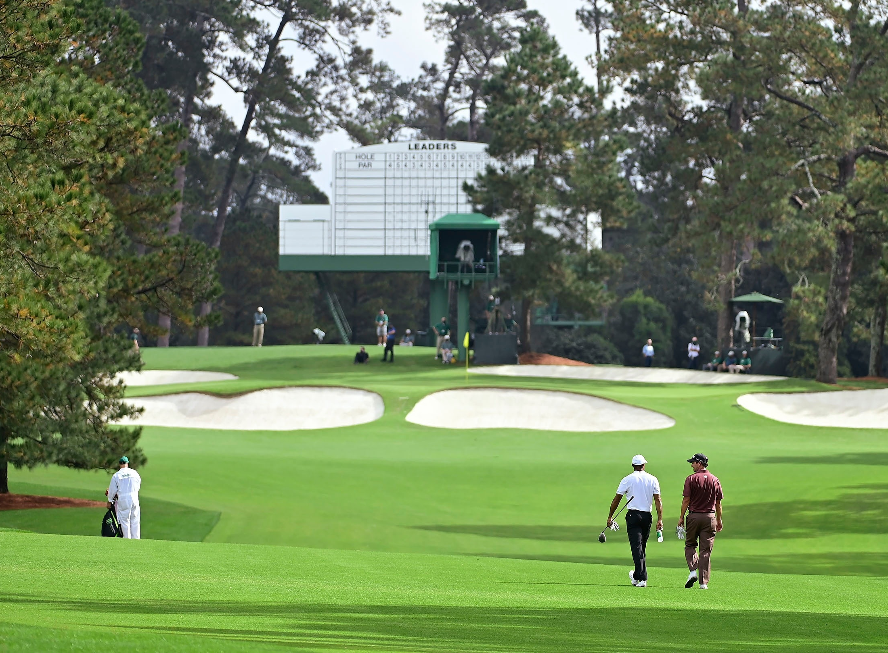
Question 2
As the players average distance per drive increases do their chances of hitting the fairway increase or decrease?
It is important to analyze this relationship because it helps determine whether players are sacrificing accuracy for distance. While longer drives can give players a better chance of reaching the green in fewer strokes, they may also be more likely to land off the fairway.

Slide 7
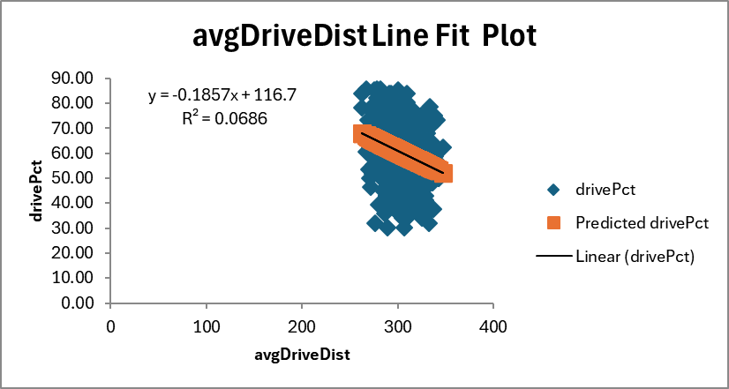
Question 2

Slide 8
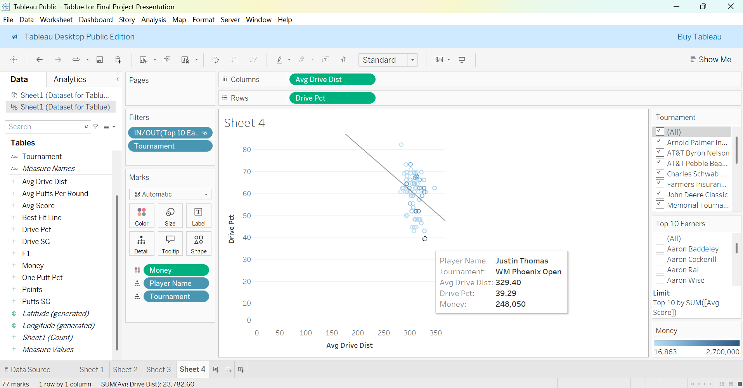
Question 2 (Top 10 Earners)

Slide 9
Question 3
Which measure of success (avgScore, Money, Points) appears to be easiest to predict with both driving and putting information?
We will use driving and putting information to predict players score, money earned, and points gained on a specific weekend.
This helps identify which part of a golfer’s game, driving or putting, has the strongest impact on their performance and results. Knowing whether these stats better predict score, earnings, or points can guide training, strategy, and recruitment on the PGA Tour.
Combining both usually improves predictions of success. If the R² value is high, it means driving and putting together explain much of the variation in avgScore, Money, or Points. If it's low, other factors likely play a bigger role in performance.

Slide 10
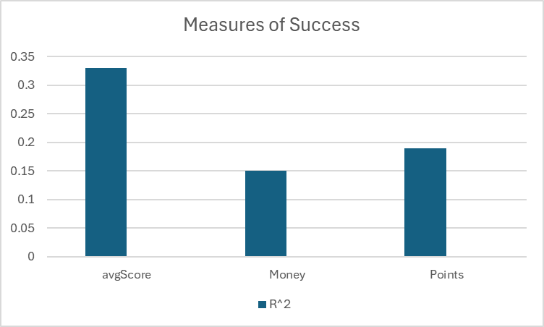
Question 3

Slide 11
Question 3 Significant Predictors for Avgscore
 | Coefficients | P-Value
avgDriveDist | -0.015994311 | 1.72945E-08
drivePct | -0.021961234 | 1.23953E-07
onePuttPct | 0.058506274 | 6.6939E-07
avgPuttsPerRound | 0.092830562 | 0.089911669
driveSG | -0.667408204 | 6.5233E-23
puttsSG | -0.852170544 | 1.49E-69

Slide 12
Question 3 Significant Predictors Money
 | Coefficients | P-Value
avgDriveDist | -274.6846848 | 0.644098489
drivePct | -363.3995611 | 0.676508326
onePuttPct | -887.695053 | 0.719307012
avgPuttsPerRound | -17638.26968 | 0.12628391
driveSG | 120422.4891 | 2.33331E-17
puttsSG | 93847.69033 | 8.34071E-22

Slide 13
Drive for Show, Putt for Dough, or is it?
Given the data from the many regression run our group thinks that driveSG has the largest impact on money earned.
It has the highest positive coefficient (120,422), meaning better strokes gained from driving results in much more money earned.
It is statistically significant with a very low p-value (2.33e-17), indicating a strong and reliable relationship.

Slide 14
Can We Predict If a Golfer Makes the CUT?
Dataset: PGA Tour player metrics — strokes gained from:
Putting
Around the Green
Approach Shots
Off the Tee
Tee to Green
We will use a Logistical Regression Model (Offers Strong Predictive Power)
Output: Ln (Odds), Estimated Odds, P(BankApproves), and Model Decision, Accuracy

Slide 15
First 15 Golfers on List - 93.33% Accuracy in predicting If a Player Makes the cut (First 15). 85% Accuracy with whole list Of names. - Strongest predictors are Tee To Green and Approach Shots -To expand this Analysis, we could Section off into Different Tournaments to see how the model Differs.
Player Name | strokes gained from putting | strokes gained around the green | strokes gained on approach shots | strokes gained off the tee | strokes gained tee to green | cut | Ln(Odds) | Estimated Odds | P(BankApproves) | Model Decision | Accuracy
A. Ancer | 0.2 | -0.13 | -0.08 | 0.86 | 0.65 | 1 | 0.42232957 | 1.525511205 | 0.604040561 | 1 | Correct
A. Hadwin | 0.36 | 0.75 | 0.31 | 0.18 | 1.24 | 1 | 0.460398109 | 1.584704745 | 0.613108614 | 1 | Correct
A. Lahiri | -0.56 | 0.74 | -1.09 | 0.37 | 0.02 | 0 | 0.385056645 | 1.469697571 | 0.595092123 | 0 | Correct
A. Long | -1.46 | -1.86 | -0.02 | 0.8 | -1.08 | 0 | 0.366332146 | 1.442434262 | 0.590572399 | 0 | Correct
A. Noren | 0.53 | -0.36 | -1.39 | 0.19 | -1.56 | 0 | 0.391864614 | 1.479737361 | 0.596731486 | 0 | Correct
A. Put0m | -0.97 | 0.14 | -2.02 | 0.31 | -1.56 | 0 | 0.339291696 | 1.403952813 | 0.584018457 | 0 | Correct
A. Rai | 2.05 | 0.74 | -1.32 | -0.12 | -0.7 | 1 | 0.448142159 | 1.565401216 | 0.610197425 | 1 | Correct
A. Schenk | -0.96 | -0.01 | 1.84 | 0.48 | 2.31 | 1 | 0.469775434 | 1.599634929 | 0.615330603 | 1 | Correct
A. Scott | -0.82 | -1.79 | 2 | -1.04 | -0.83 | 1 | 0.483743629 | 1.622135724 | 0.618631488 | 1 | Correct
A. Smalley | -1.89 | -0.71 | 0.71 | -0.65 | -0.65 | 0 | 0.417276318 | 1.517821856 | 0.602831313 | 1 | Wrong
A. Svensson | 0.28 | -0.02 | -0.18 | 0.26 | 0.07 | 1 | 0.434268028 | 1.543832603 | 0.606892372 | 1 | Correct
A. Wise | 1.16 | 0.05 | 1.96 | 0.18 | 2.19 | 1 | 0.531033616 | 1.700689261 | 0.629724154 | 1 | Correct
S. Theegala | 0.06 | 0.4 | 1.48 | 0.65 | 2.54 | 1 | 0.486361663 | 1.626388094 | 0.619248959 | 1 | Correct
B. Hagy | -0.94 | -1.58 | -1.41 | -0.61 | -3.6 | 0 | 0.354887762 | 1.426020592 | 0.587802345 | 0 | Correct
B. Harman | 0.12 | 0.66 | 0.17 | 0.65 | 1.48 | 1 | 0.441149778 | 1.554493514 | 0.608532966 | 1 | Correct
 |  |  |  |  |  |  |  |  |  |  | 93.33%

Slide 16
Questions?

